Slide 1
Upstream processes
Product and Service Lifecycle Management
Prospect To Quote
Define sales strategy
Run marketing campaigns
Downstream processes
Identify and qualify leads
Pursue opportunities
Estimate and quote sales
Manage customer relationships
Inventory to Deliver
Order to Cash
Service to Cash
Project to Profit
Forecast to Plan
Analyze service operations
Notes:
End to end process relationship diagram example
Order to cash process relationship
The following diagram shows the relationship of other processes and products/features for the order to cash process. The prerequisites for the order to cash process include product design to retire and prospect to quote processes. The order to cash end-to-end process is broken down into the following business process areas including:
Manage pricing and contracts
Create and manage sales orders
Trade across companies
Issue customer invoices
Record customer payments
Monitor customer credit and collections
Process customer rebates
The third column in the diagram displays the downstream business process which includes inventory to deliver, case to resolution, and record to report. In some operating strategies, such as make to order or purchase to order, the procure to pay and plan to produce end-to-end processes may be part of the downstream business process flow. However, this article does not detail those scenarios. The final column in the graphic displays additional capabilities in Dynamics 365 that are dependent on the order to cash process to include, but not limited to Sales accelerator, Demand forecasting, Customer insights, Finance insights, Dynamics 365 Fraud Protection, Dynamics 365 Intelligent Order Management.

Slide 2
Prospect To Quote
Start
Product and Service Lifecycle Management
Define sales strategy
Order to Cash
Forecast to Plan
Run Marketing Campaigns
Service to Cash
Project to profit
Identify and Qualify Leads
Inventory to Deliver
Pursue Opportunities
Estimate and Quote Sales
Manage Customer Relationships
Analyze Service Operations
End
Notes:
Upstream Processes:
Product and Service Lifecycle Management: This process informs the sales strategy and marketing campaigns, as it helps define the products and services to be promoted.
Forecast to Plan: Market forecasts can guide the sales strategy, marketing campaigns, and lead identification.
Project to Profit: Insights from previous projects can inform the sales strategy, lead qualification, and the pursuit of opportunities.
Downstream Processes:
Order to Cash: Once a quote is accepted, the order to cash process starts, which includes order management, fulfillment, invoicing, and payment collection.
Service to Cash: This process is applicable for service-based organizations. After estimating and quoting sales, the service delivery and invoicing occur, followed by payment collection.
Inventory to Deliver: This process is related to product availability and delivery, which can impact the accuracy of quotes and the customer relationship management.
Here's how these business processes interact with the prospect-to-quote subprocesses:
Define Sales Strategy: Upstream processes like Product and Service Lifecycle Management, Forecast to Plan, and Project to Profit provide insights that help shape the sales strategy.
Run Marketing Campaigns: Market research from the Forecast to Plan process can guide marketing campaigns

Slide 3
Prospect To Quote
Start
Create Sales Quotations
Product and Service Lifecycle Management
Define sales strategy
Add Products to Sales Quotations
Revise Sales Quotations
Forecast to Plan
Run Marketing Campaigns
Create or Edit Sales Quotations
Project to profit
Identify and Qualify Leads
Email Quotations
Manage Sales Quotations
Pursue Opportunities
Print Quotations
Convert
Close
Revise
Estimate and Quote Sales
Create a Sales Order from a Sales Quotation
Close Quotations as Lost or Cancelled
End
Manage Customer Relationships
Analyze Service Operations
End
Order to Cash
Service to Cash
Inventory to Deliver
Notes:
Upstream Processes:
Product and Service Lifecycle Management: This process informs the sales strategy and marketing campaigns, as it helps define the products and services to be promoted.
Forecast to Plan: Market forecasts can guide the sales strategy, marketing campaigns, and lead identification.
Project to Profit: Insights from previous projects can inform the sales strategy, lead qualification, and the pursuit of opportunities.
Downstream Processes:
Order to Cash: Once a quote is accepted, the order to cash process starts, which includes order management, fulfillment, invoicing, and payment collection.
Service to Cash: This process is applicable for service-based organizations. After estimating and quoting sales, the service delivery and invoicing occur, followed by payment collection.
Inventory to Deliver: This process is related to product availability and delivery, which can impact the accuracy of quotes and the customer relationship management.
Here's how these business processes interact with the prospect-to-quote subprocesses:
Define Sales Strategy: Upstream processes like Product and Service Lifecycle Management, Forecast to Plan, and Project to Profit provide insights that help shape the sales strategy.
Run Marketing Campaigns: Market research from the Forecast to Plan process can guide marketing campaigns

Slide 4
Prospect To Quote
Start
Create Sales Quotations
Product and Service Lifecycle Management
Define sales strategy
Add Products to Sales Quotations
Revise Sales Quotations
Manage Customer Relationships
Forecast to Plan
Run Marketing Campaigns
Create or Edit Sales Quotations
Manage Sales Quotations
Analyze Service Operations
Project to profit
Identify and Qualify Leads
Email Quotations
Convert
Close
Revise
End
Pursue Opportunities
Print Quotations
Estimate and Quote Sales
Order to Cash
Create a Sales Order from a Sales Quotation
Close Quotations as Lost or Cancelled
Service to Cash
Inventory to Deliver
Notes:
Upstream Processes:
Product and Service Lifecycle Management: This process informs the sales strategy and marketing campaigns, as it helps define the products and services to be promoted.
Forecast to Plan: Market forecasts can guide the sales strategy, marketing campaigns, and lead identification.
Project to Profit: Insights from previous projects can inform the sales strategy, lead qualification, and the pursuit of opportunities.
Downstream Processes:
Order to Cash: Once a quote is accepted, the order to cash process starts, which includes order management, fulfillment, invoicing, and payment collection.
Service to Cash: This process is applicable for service-based organizations. After estimating and quoting sales, the service delivery and invoicing occur, followed by payment collection.
Inventory to Deliver: This process is related to product availability and delivery, which can impact the accuracy of quotes and the customer relationship management.
Here's how these business processes interact with the prospect-to-quote subprocesses:
Define Sales Strategy: Upstream processes like Product and Service Lifecycle Management, Forecast to Plan, and Project to Profit provide insights that help shape the sales strategy.
Run Marketing Campaigns: Market research from the Forecast to Plan process can guide marketing campaigns

Slide 5
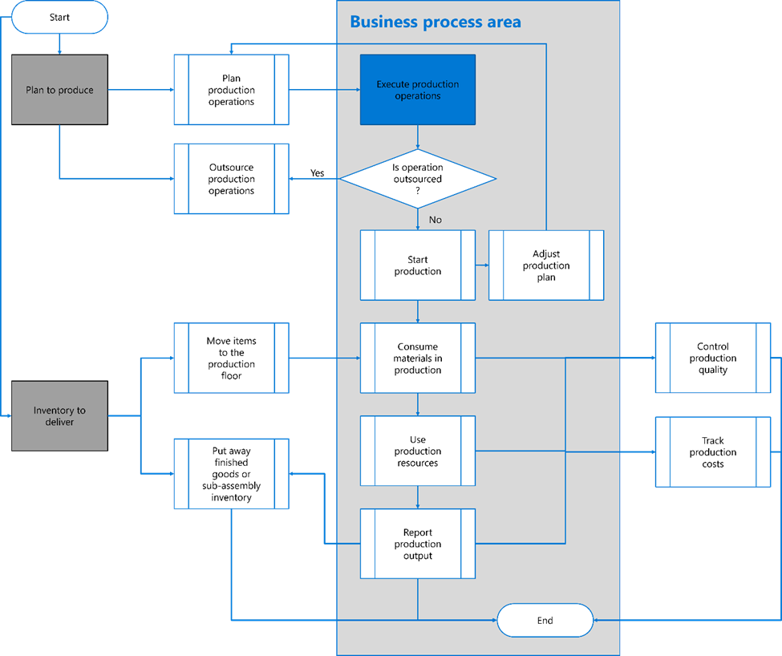
Quote
Notes:
Upstream Processes:
Product and Service Lifecycle Management: This process informs the sales strategy and marketing campaigns, as it helps define the products and services to be promoted.
Forecast to Plan: Market forecasts can guide the sales strategy, marketing campaigns, and lead identification.
Project to Profit: Insights from previous projects can inform the sales strategy, lead qualification, and the pursuit of opportunities.
Downstream Processes:
Order to Cash: Once a quote is accepted, the order to cash process starts, which includes order management, fulfillment, invoicing, and payment collection.
Service to Cash: This process is applicable for service-based organizations. After estimating and quoting sales, the service delivery and invoicing occur, followed by payment collection.
Inventory to Deliver: This process is related to product availability and delivery, which can impact the accuracy of quotes and the customer relationship management.
Here's how these business processes interact with the prospect-to-quote subprocesses:
Define Sales Strategy: Upstream processes like Product and Service Lifecycle Management, Forecast to Plan, and Project to Profit provide insights that help shape the sales strategy.
Run Marketing Campaigns: Market research from the Forecast to Plan process can guide marketing campaigns

Slide 6
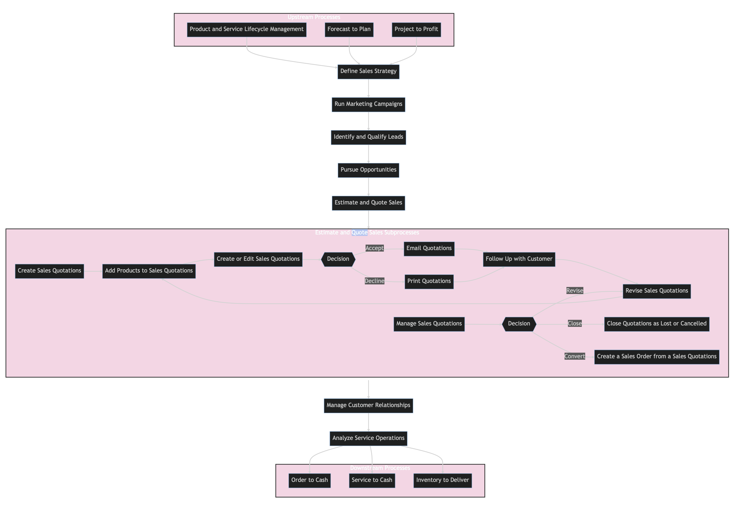
Quote
Notes:
Upstream Processes:
Product and Service Lifecycle Management: This process informs the sales strategy and marketing campaigns, as it helps define the products and services to be promoted.
Forecast to Plan: Market forecasts can guide the sales strategy, marketing campaigns, and lead identification.
Project to Profit: Insights from previous projects can inform the sales strategy, lead qualification, and the pursuit of opportunities.
Downstream Processes:
Order to Cash: Once a quote is accepted, the order to cash process starts, which includes order management, fulfillment, invoicing, and payment collection.
Service to Cash: This process is applicable for service-based organizations. After estimating and quoting sales, the service delivery and invoicing occur, followed by payment collection.
Inventory to Deliver: This process is related to product availability and delivery, which can impact the accuracy of quotes and the customer relationship management.
Here's how these business processes interact with the prospect-to-quote subprocesses:
Define Sales Strategy: Upstream processes like Product and Service Lifecycle Management, Forecast to Plan, and Project to Profit provide insights that help shape the sales strategy.
Run Marketing Campaigns: Market research from the Forecast to Plan process can guide marketing campaigns

